Slide 2
Get Ready…
PUT YOUR “BUSINESS HAT” ON!
New Economy
40/40/40 is not the answer
95% will retire broke
The wealthiest people in the world
do not have “jobs”
Business ownership is the American Dream

Slide 3
Options
WORK MORE HOURS
Not even possible on many jobs
GO BACK TO SCHOOL
Time commitment, expensive, no guarantee
PART TIME JOB
50 - 70 hours week, Typically doesn’t pay as well
FRANCHISE
$50,000 to $5 million (KFC is $2.5 million)

Slide 4
A New Model
Direct Selling Industry
Start Part Time
Earn while you Learn
Leverage
Low start-up fees
FUN, EXCITING, HUGE INDUSTRY!

Slide 5
The Travel Industry
LARGEST INDUSTRY IN THE WORLD
Television $ 384,000,000,000
Pharmaceuticals $ 950,000,000,000
Computers/Technology $ 1,100,000,000,000
TRAVEL $ 8,100,000,000,000
Yesterday?
$18 BILLION

Slide 6
How can YOU participate?
YOU KNOW A LOT OF PEOPLE
Columbia University Study: 600 avg.
Facebook: 383 friends/avg.
99% ALREADY TRAVEL
No convincing or selling
WE CAN SHOW YOU HOW TO
Make money while saving them money
3 ADDITIONAL WAYS TO EARN

Slide 7
#1 -
Family of 4 to San Diego (hotel, car, tickets)
Site “A” $ 1,008^{.00}
Site “B” $ 999^{.00}
The Vortex $ 949^{.00}
SAME HOTEL, SAME BEACH, SAME SAND.
YOUR COMMISSION? $200-$300

Slide 8
Get paid to POINT
Let’s say… 500 Friends
20% of Those Book a Similar Trip
Worldwide Customers
100 trips/year x $250 commission =
$25,000
WHAT IF 30%? 40%?

Slide 9
#2 -
Become a Specialist
Hawaii, Destination Wedding, Holy Land
Groups (cruises, diving, golf, yoga)
Go for Free
Earn BIG Commissions
“Earned $40,000 for Holy Land trip for church”
Jackie F.

Slide 10
#3 Build a Team
Refer 3 and Yours is Free
Refer 7 earn $1,000 bonus
Refer 100 (team, not personally)
14 $1,000 Bonuses $14,000
100 Active Member Bonus $10,000
Overrides of at least… $ 2,000
Total Earnings $26,000

Slide 11
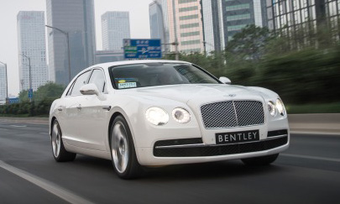
#4 Build an EMPIRE
Full time, management level income
Director Program
Company car
Charger
Jaguar, BMW, or Mercedes
Bentley GTC or Flying Spur
Extra $2,000 to $12,000
monthly bonus
$1,000,000 bonus at
Presidential Director

Slide 12
Surge Business Associate
100% MATCH personally sponsored Team Builder’s
UNLIMITED $1,000 Bonuses paid thru INFINITY
UNLIMITED $10,000 Bonuses paid thru INFINITY
OVERRIDE $1,000 & $10,000 Bonuses
OVERRIDE 6 INFINITY Generations
Up to $6 RESIDUAL on 6 INFINITY Generations

Slide 13
Travel Membership
We sell an affordable, exclusive Travel Club Membership
Access to hundreds of thousands of hotels around the globe
Vacation resorts, condos and all-inclusives
Cruises, tour packages, guided tours
Prices so low they can NOT be shared with the public
Reward credit loyalty program
110% price match guarantee
Week in Paris 5 Star Hotel
Public Price: $6,755
Savings: $5,463
You Pay
$1,292

Slide 14
Getting Started
The Vortex (retail value: $600)
Make Money While You Sleep
Membership (retail value: $4,000)
Travel like a Rockstar for Pennies On the Dollar
400,000 Hotels, Resorts, All-Inclusives, Cruises, Car Rentals, etc
Reward Credits
Concierge service
PTN Travel Agency (retail value: $499)
Group Travel Commissions
OVER $5,000 IN VALUE
Only $399 and $59.95/mo - Includes SBA fee, SurgeAPP, WBA

Slide 15
International Expansion
International Compensation Plan
Launching in 25 countries
Only $88 set up fee to participate

Slide 16
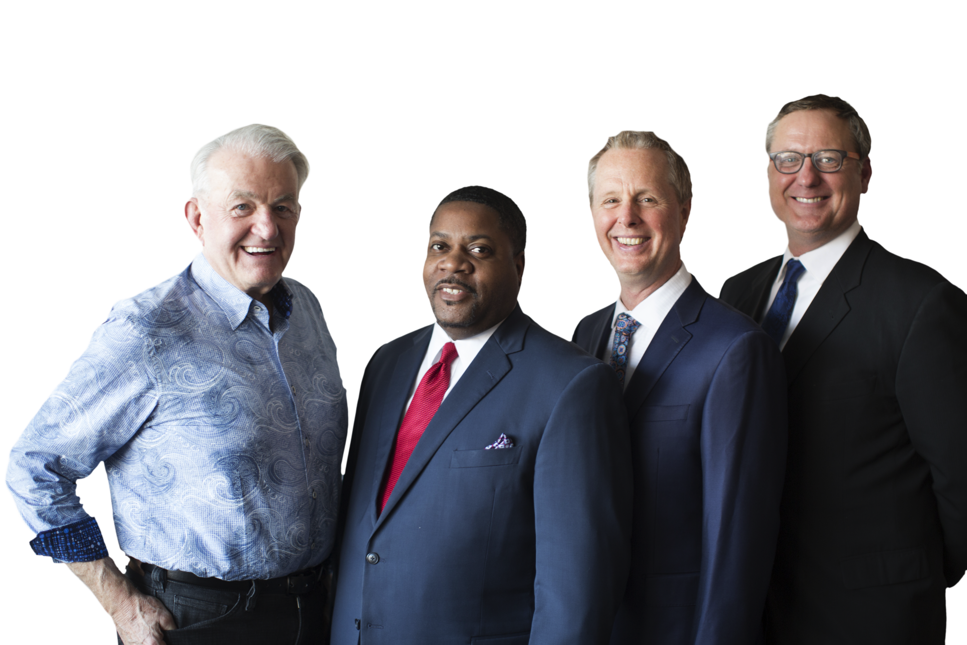
EXECUTIVE TEAM
Chris Cokley has held positions from Vice President of Marketing to Executive Sales Director to CEO, with some of the leading companies in the home based travel agent arena. Chris has long been one of the most sought after mentors and trainers in the industry.
Scott Tomer has over 30 years of experience in Direct Sales as both a top income earning Distributor and as Co-Founder and CEO of a major, publicly traded travel company. His expertise in marketing compensation plans and leadership training are legendary in the Network Marketing industry.

Slide 17
EXECUTIVE TEAM
James Tackett is recognized as one of the top media and marketing professionals in Network Marketing. As a consultant, he has produced video and marketing tools for over 50 different Direct Sales companies including many billion dollar brands like Avon, Herbalife, and Primerica.
Lloyd “Coach” Tomer is a former paratrooper, pastor, and multi-million dollar earner. He is recognized as one of the greatest recruiters in the history of network marketing, helping hundreds of thousands of individuals all across the country get more out of life through the Direct Sales industry.

Slide 18
Tools and Training
SurgeAPP
Wealth Builder Academy
Social Media Training
Websites and Free Marketing Videos
Incentive Trips
Contests and Bonuses
Recognition and FUN

Slide 19
Three Outcomes…
“I see the potential and I’m ready to build an empire.”
“I see the value and want to make money on the travel of my social network and get the perks of Membership.”
“I’m not ready to start a business but I will definitely check your Vortex site first when I purchase travel.”

Slide 20
One Last Thought…

